Slide 1
TRUST IN CRYPTOCURRENCY
Course: BIA 658-B Social Network Analysis
Prepared By: Maulik Jajal
Student Id: 10421667
Guided By: Prof. Elizabeth Gomez

Slide 2
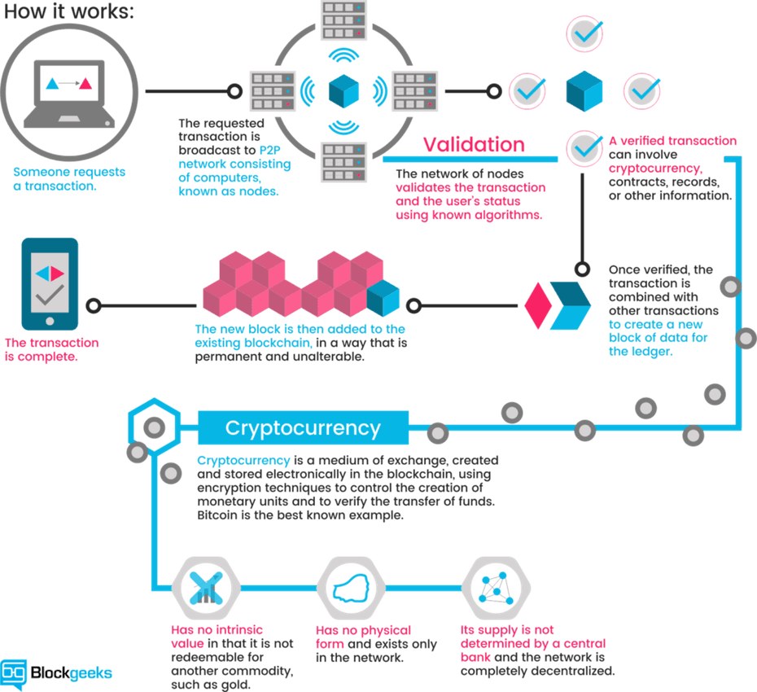

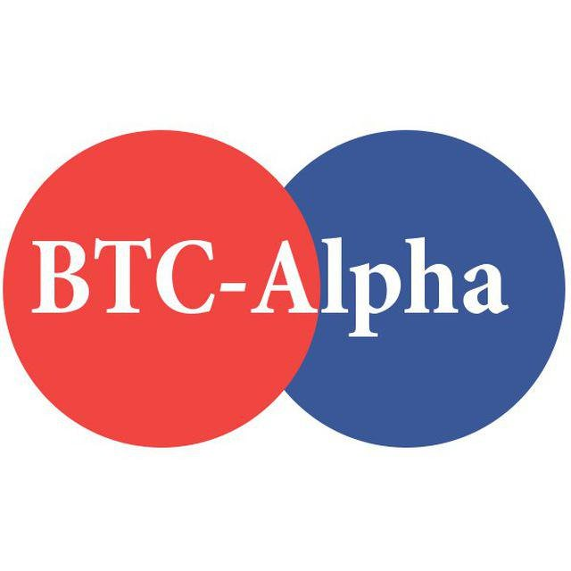
CRYPTOCURRENCY

Slide 3



BITCOIN ALPHA
Bitcoin Alpha: Who-trusts-whom network of people who trade Bitcoins.
Bitcoin users are anonymous.
Maintain a record of users' reputation
To prevent transactions with fraudulent and risky users.
Members of Bitcoin Alpha rate other members in a scale of
-10 (TOTAL DISTRUST) TO +10 (TOTAL TRUST)
Website: https://btc-alpha.com/exchange/

Slide 4


DATASET
Data format: SOURCE, TARGET, RATING, TIME
SOURCE: Node id of source, i.e., rater
TARGET: Node id of target, i.e., ratee
RATING: Source's rating for the target, ranging from -10 to +10 in steps of 1
TIME: The time of the rating, measured as seconds since Epoch. ( 2010 – 2016 )
Dataset URL: https://snap.stanford.edu/data/soc-sign-bitcoinalpha.html
SOURCE | TARGET | RATING | TIME
160 | 25 | 10 | 1394683200
95 | 35 | 9 | 1384578000
377 | 513 | -7 | 1414728000
SOURCE | TARGET | WEIGHT | TIME
160 | 25 | 10 | 3/13/2014
95 | 35 | 9 | 11/16/2013
377 | 513 | -7 | 10/31/2014

Slide 5
DATASET
Dataset statistics
Nodes | 3,783
Edges | 24,186
Range of edge weight | -10 to +10
Percentage of positive edges | 93%

Slide 6

PROFOUND QUESTIONS
Is a user a fraud user? Giving most reviews as Distrust rates.
Does some month have significantly high Distrust transaction than another month or not?

Slide 7
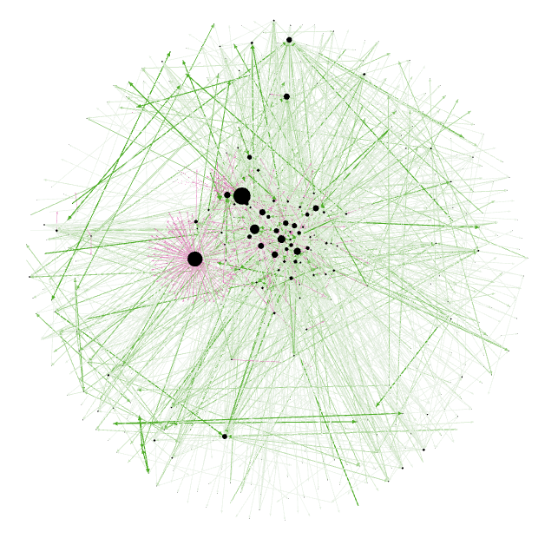

VISUALIZATION
Graph statistics
Nodes | 3,783
Edges | 24,186
Layout | Yifan Hu Proportional

Slide 8
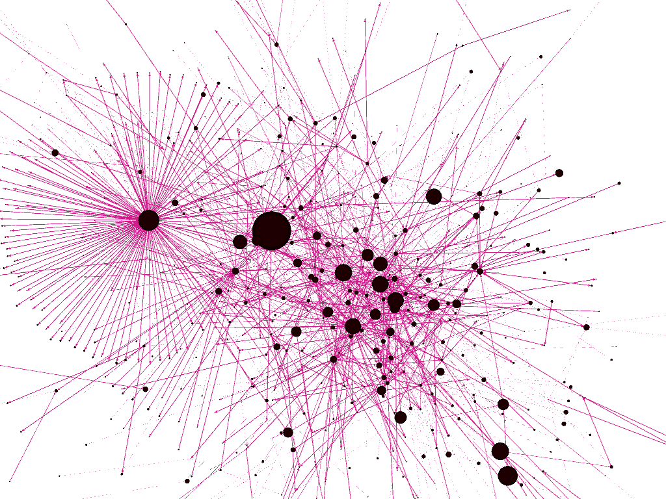
VISUALIZATION
D
I
S
T
R
U
S
T

Slide 9
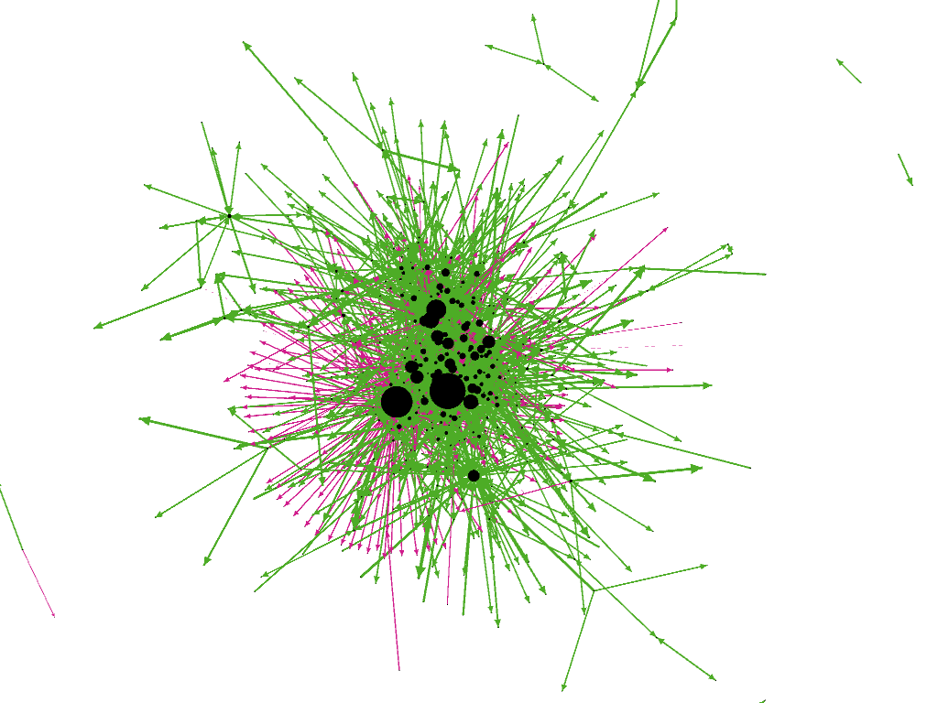
VISUALIZATION
2014
Graph statistics
Nodes | 715
Edges | 2736
Year | 2014
Layout | Yifan Hu Proportional

Slide 10
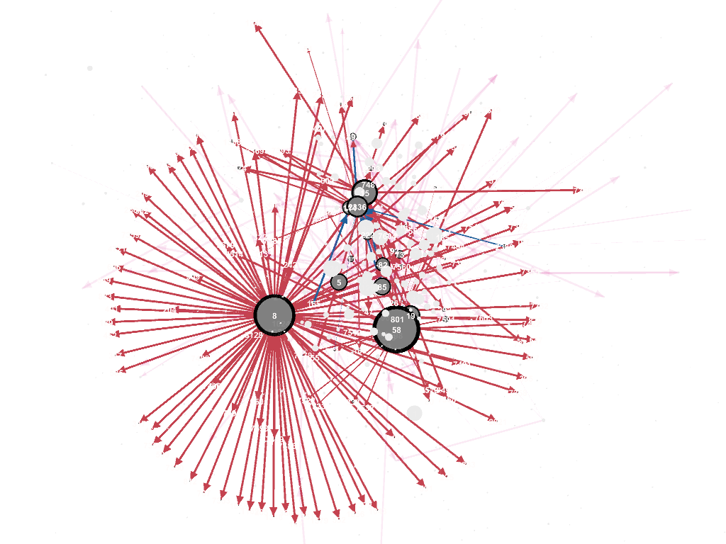
VISUALIZATION
2014
#386

Slide 11
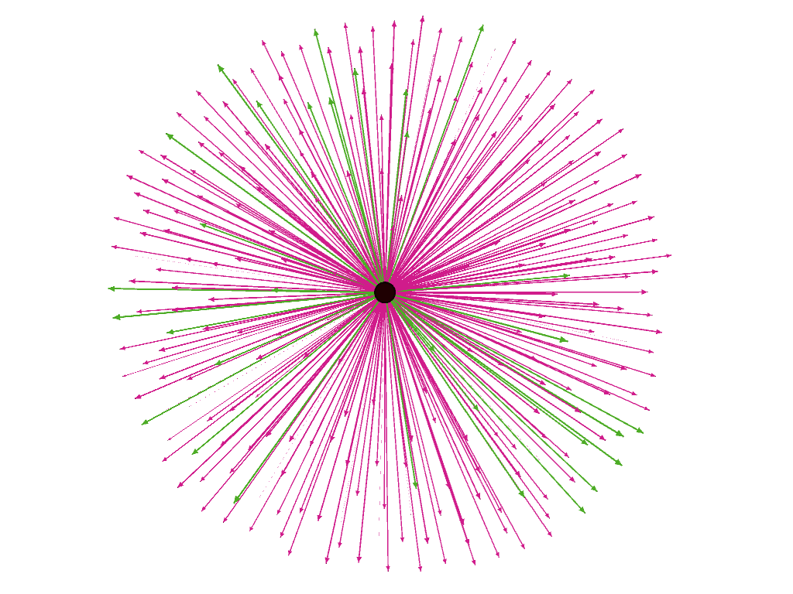

VISUALIZATION
Node: 8
Graph statistics
Edges | 260 (Out Degree)
Positive | 63
Negative | 197 (75.76%)

Slide 12
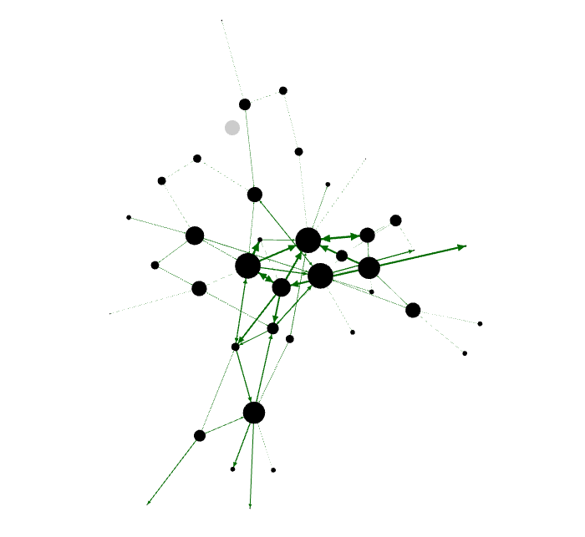
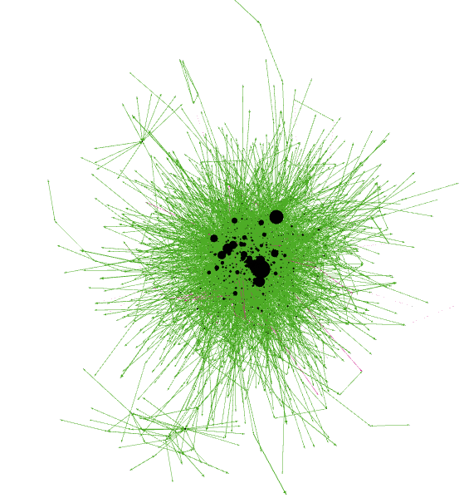
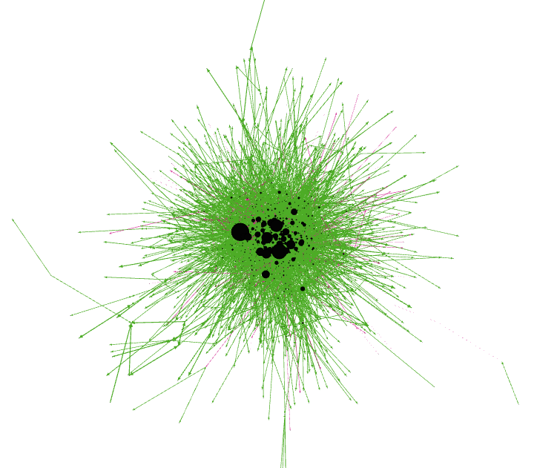
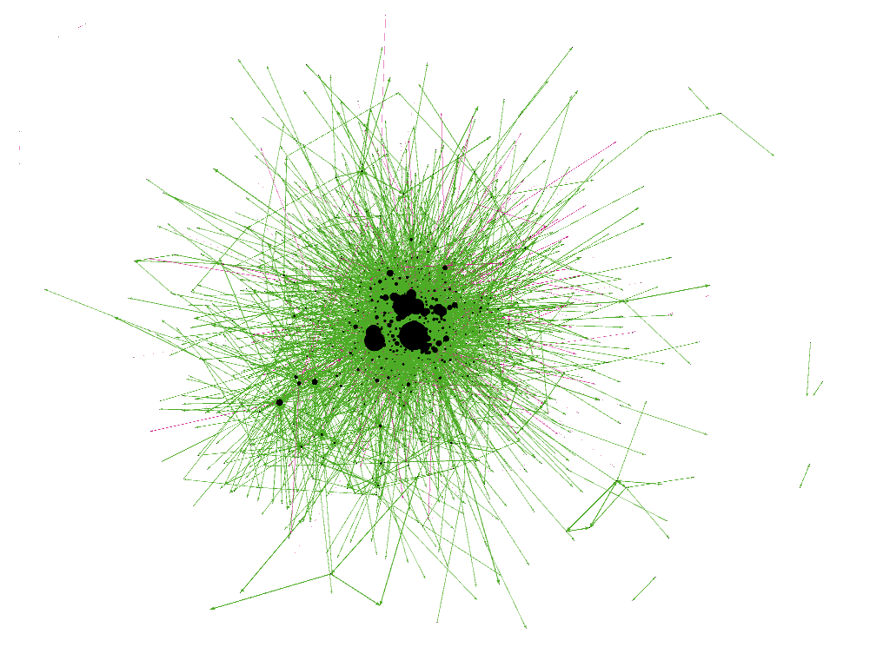
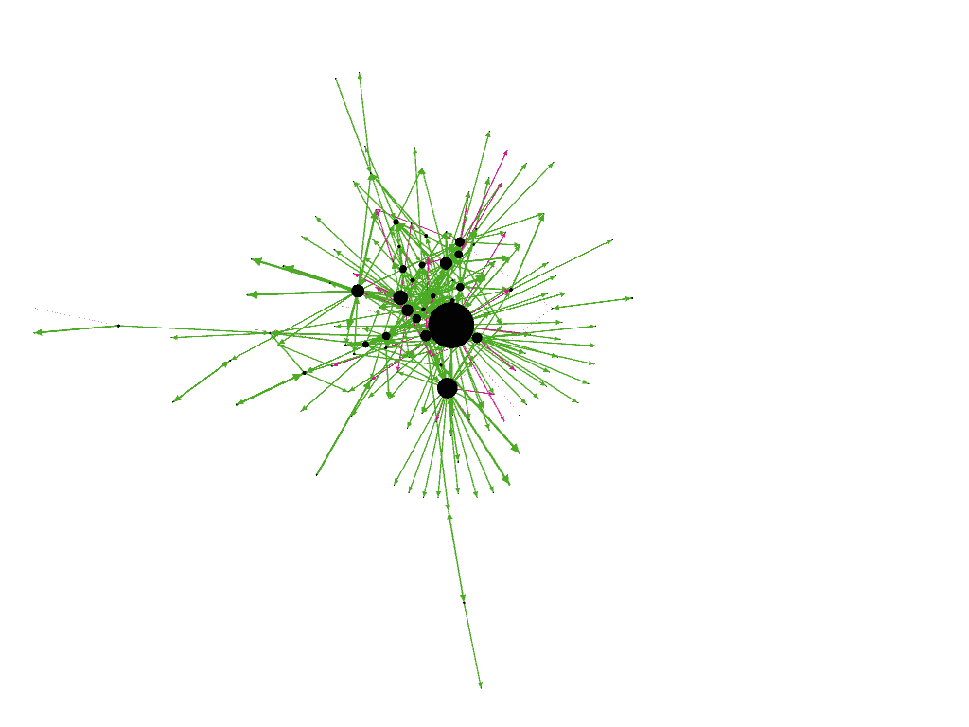
VISUALIZATION
2010
#89
2011
#7604
2012
#7251
2013
#6122
2014
#2736
2015
#363

Slide 13
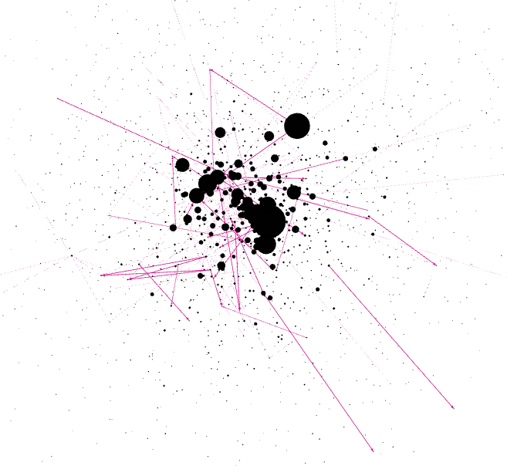
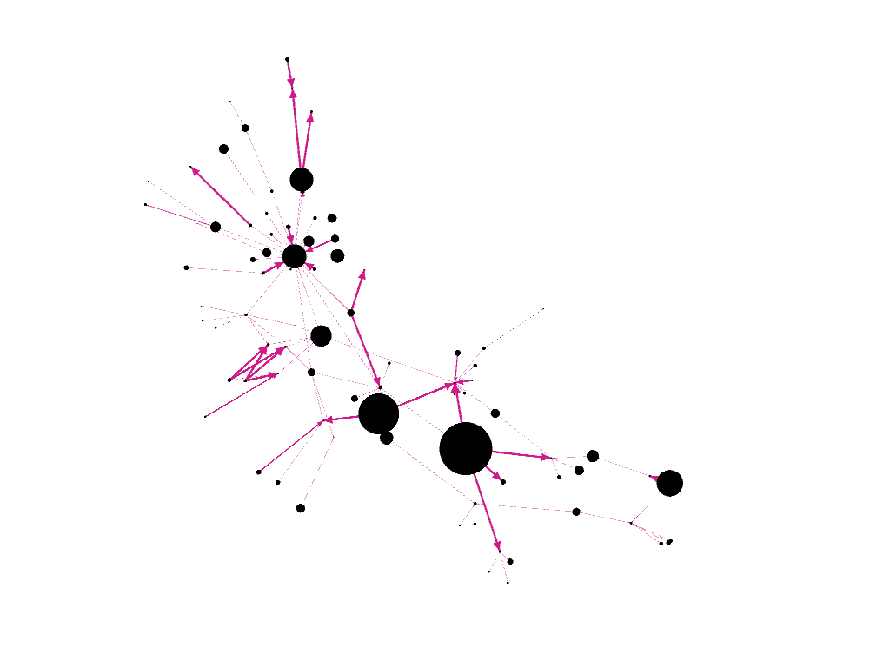
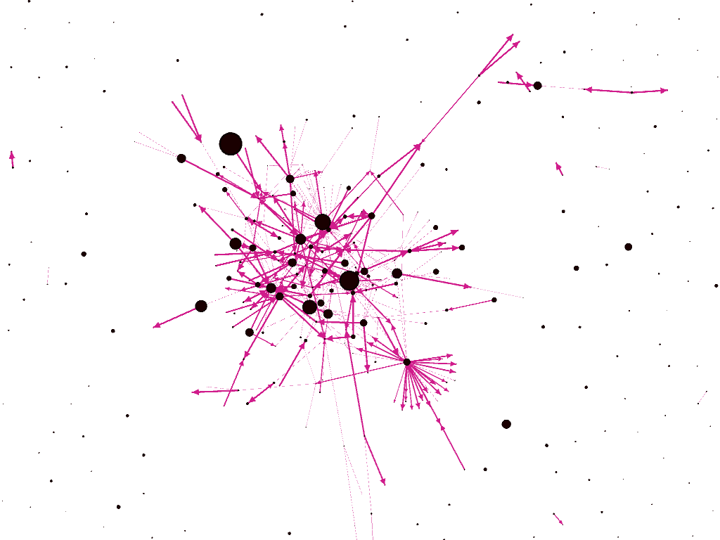
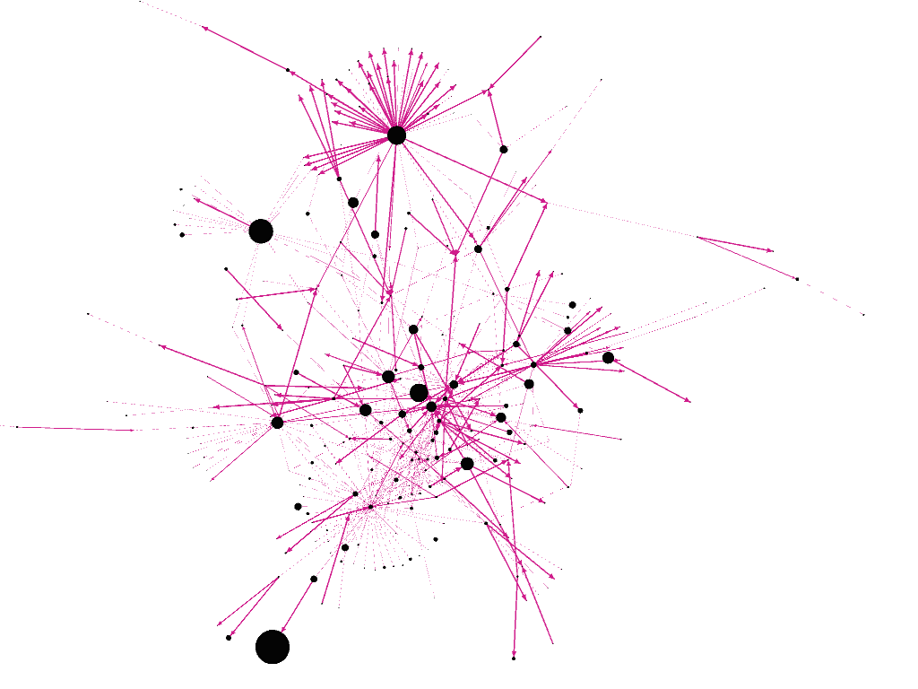
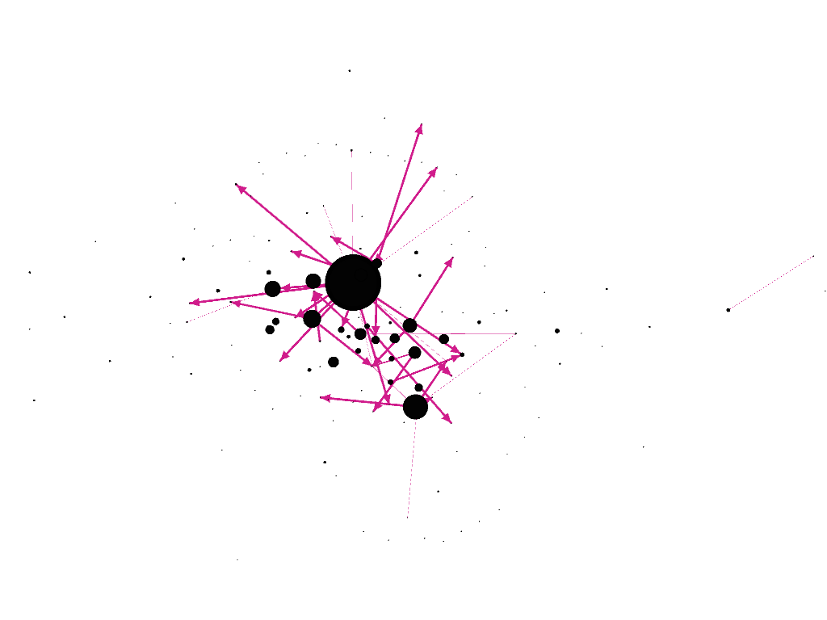
VISUALIZATION
2010
#0
2011
#149
2012
#380
2013
#551
2014
#386
2015
#42

Slide 14
VISUALIZATION

Slide 15
VISUALIZATION

Slide 16
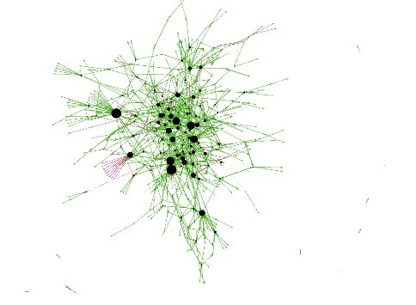
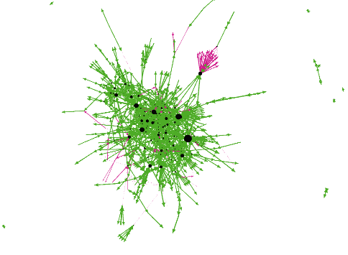
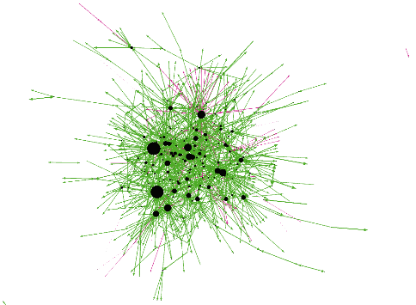
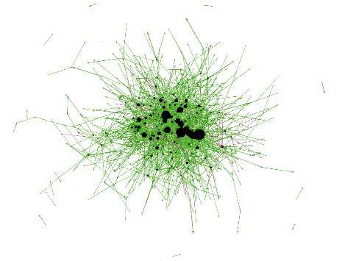
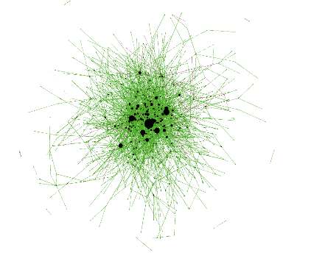
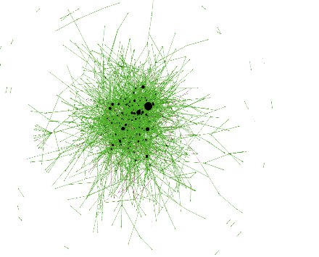
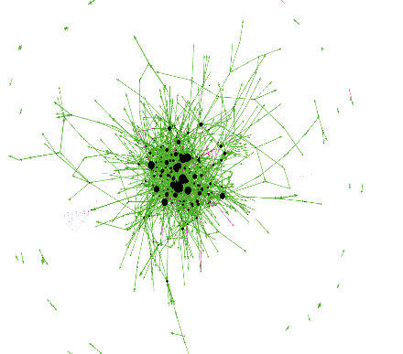
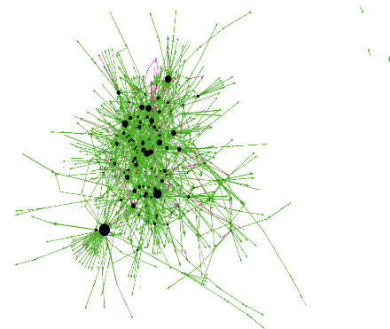
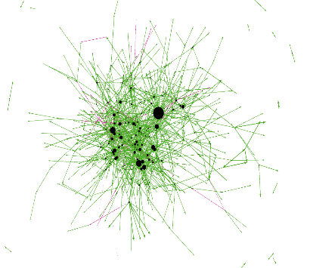
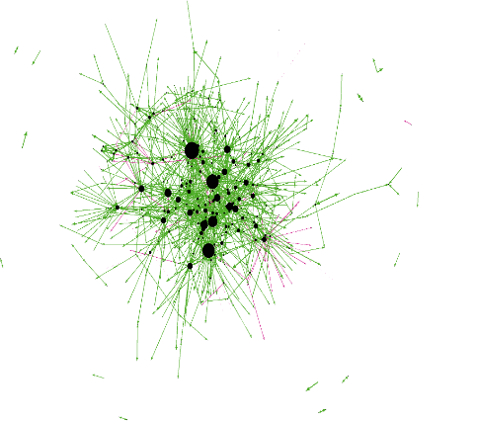
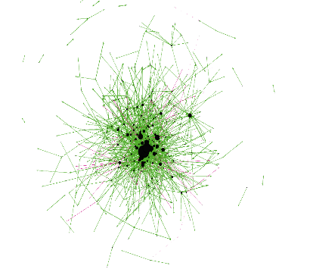
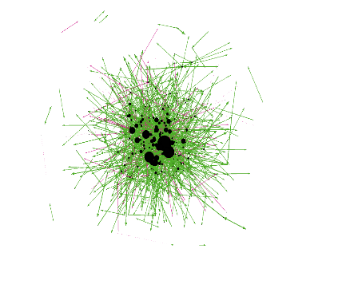
VISUALIZATION
Jan
#1349
Feb
#1466
Mar
#1763
Apr
#2339
May
#2260
Jun
#3823
Jul
#1977
Aug
#1909
Sep
#1453
Oct
#1428
Nov
#1629
Dec
#1702

Slide 17
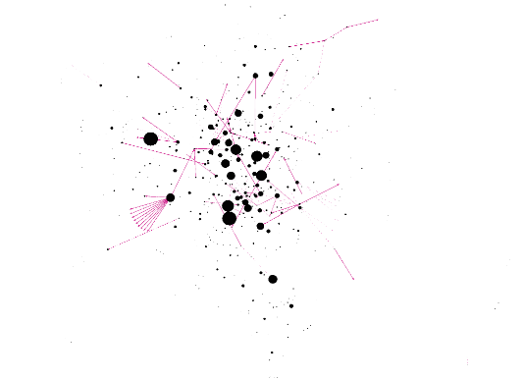
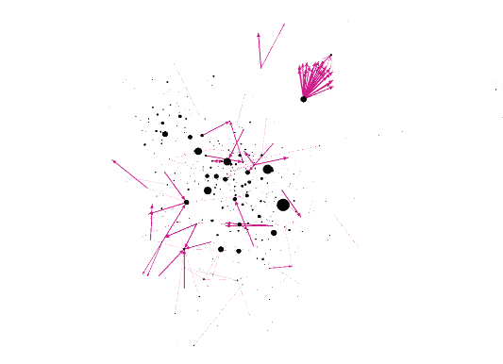
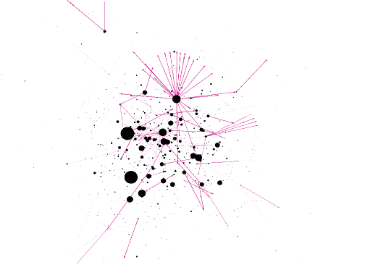
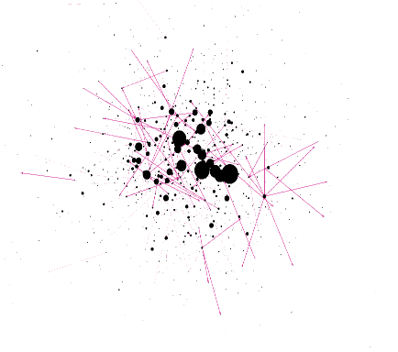
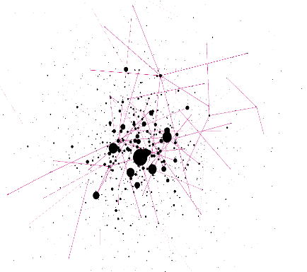
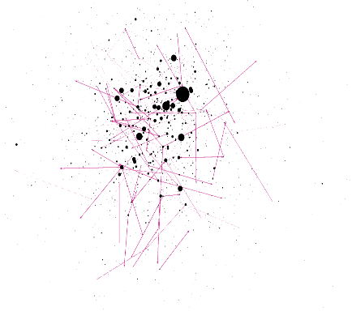
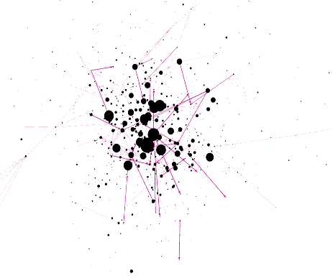
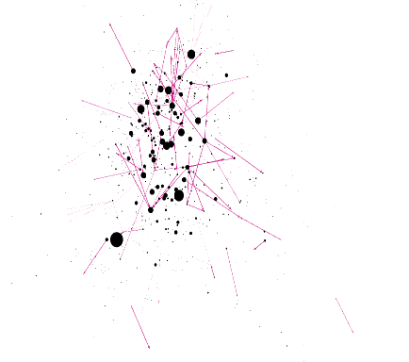
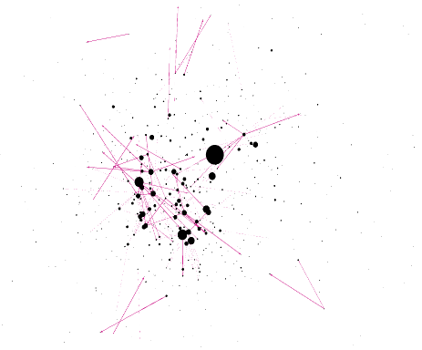
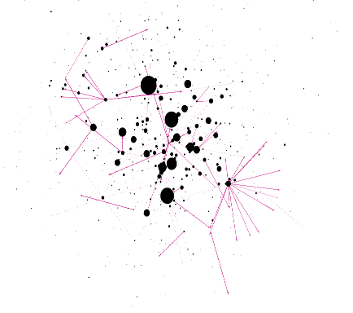
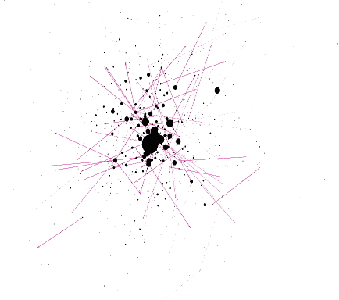
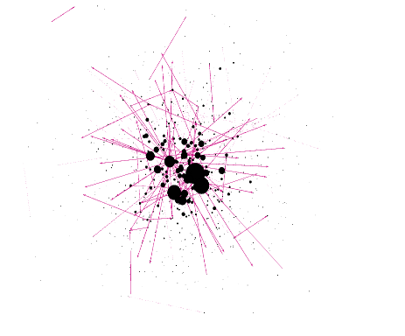
VISUALIZATION
Jan
#103
Feb
#121
Mar
#184
Apr
#140
May
#125
Jun
#140
Jul
#124
Aug
#132
Sep
#137
Oct
#91
Nov
#109
Dec
#151

Slide 18
CONCLUSION
Based on Out-degree of distrust transaction one can describe as Fraud user.
March, September, and December months have more number of distrust transaction than other months.
May, and June months have less number of distrust transaction than other months.

Slide 19
Thank You

